Slide 1




Presented By:
Team A - TDAI DA360 Live
Charles John
Mark Pereira
Amrit Malla
Airbnb Property Investment

Slide 2
Agenda
Introduction
Data Overview
Data Cleaning and Preparation
Analysis of Neighbourhood popularity
Findings and Recommendations
Conclusion

Slide 3
Introduction
Objective: Should our investor invest in an Airbnb property in Washington, D.C.? If so, in which neighborhood and property type?
Provide data-driven insights and recommendations on profitable real estate investments in the U.S
Sub-prompt Focus: Neighbourhood Popularity.
The Data has to be looked for reviews, ratings, No of listings.
Notes:
Provide data-driven insights and recommendations on profitable real estate investments in the U.S."
"Identify key types of properties and neighborhoods in Washington D.C. that maximize investment returns."

Slide 4
Context This report aims to find the best neighborhood clusters in Washington D.C. for Airbnb property investment.
Background
Objective
Data & Assumption
Client want to invest in Airbnb properties in Washington DC area. He wants to know;
Whether it would be a good investment
What neighborhoods to focus
What type of properties are most suitable
Objective 1: Is Washington DC a good place to invest
Objective 2: If yes, what is the best demographics for investment
Objective 3: Which neighborhoods in Washington DC has the most listings
Dataset:
The dataset is from scraped data of listings from Airbnb.
The dataset has 3724 rows with one listing each.
The dataset shows information such as a unique listing id, location, price, review ratings etc.
The dataset needs to be cleaned, and assumptions needs to be made to find out revenue generated.
Assumptions:
No. bookings per month = Twice the no. reviews per month.
Each booking stayed for a minimum night(s) available per listing.
The time between the first and last date of reviews are considered as the time a listing was active. This metric is used to calculate the growth of the area in the last 12 months.

Slide 5
Approach A 5-step approach was taken to develop this report starting from defining the question to visualizing the data.
Focus of today’s presentation
Define
Collect
Clean
Analyze
Present & Share
The data was analysed from different angles to derive various insights;
Actual and potential revenues of the listings were calculated based on assumptions detailed before.
A revenue score was assigned to find out neighbourhoods that generate revenue closer to potential revenues
Average revenue per property and revenue score was used to identify potential investments.
Client want to invest in Airbnb properties in Washington DC area. He wants to know;
Whether it would be a good investment
What neighborhoods to focus
What type of properties are most suitable
The dataset is from scraped data of listings from Airbnb.
The data has 3724 rows with one listings each.
The dataset shows information such as a unique listing id, location, price, review ratings etc.
The dataset has missing values in columns like reviews, and some duplicate values. Therefore, the data needs to be cleaned.
The following final insights are shared with the client;
The growth in the area in the last 12 months.
Potential of growth based on current revenue and potential earnings
Best neighbourhoods and property types of investments
Neighbourhood with the most listings

Slide 6
Data Overview
Analyzing 3,723 Airbnb listings across Washington D.C., encompassing a diverse range of data points including host details, pricing, location, and guest reviews.
Initial data review shows the need for significant cleaning and standardization.
The Data has 3723 rows and 92 Columns
There is a lot of missing data it has to be cleaned before performing analysis.

Slide 7
Data Cleaning & Preparation
Original Data Issues:
Duplicates
Listings without reviews
Inconsistent Data
Cleaning Methods:
Filtered out listings with no reviews (number_of_host_name=0) (830 Listings).
Standardized text data for State, City and Neighbourhood.
Tools Used: Excel for initial cleaning.
Notes:
Used the filter option to filter the rows without 0 reviews - We can see that there are 830 listnings with zero reviews
never delete the data prefer hiding
Never play with the raw dta make a copy and play with it
Understand the Data , go through each column
go through the rows to check the information
Changed the headers to BOLD
Click on wrap text to wrap the text along the columns
Double click after the first row u can see the name of the columns
Deleted the Scrape_ID and Last_Scraped Columns which really are of no use

Slide 8
Data Cleaning & Quality Check
Deleted 78 unwanted Columns (Prompt 3) which are of no use for our analysis
Columns containing URLs.
Columns containing long descriptions.
Columns containing single data or no data.
Columns containing data that add no value to our analysis
Added Columns
Actual revenue per year, Potential Yearly Revenue , Is this a revenue generating property , Monthly Revenue , Revenue Score , Top choice score
Notes:
Used the filter option to filter the rows without 0 reviews - We can see that there are 830 listnings with zero reviews
never delete the data prefer hiding
Never play with the raw dta make a copy and play with it
Understand the Data , go through each column
go through the rows to check the information
Changed the headers to BOLD
Click on wrap text to wrap the text along the columns
Double click after the first row u can see the name of the columns
Deleted the Scrape_ID and Last_Scraped Columns which really are of no use

Slide 9
Data Cleaning & Quality Check
Filtering and Further cleaning
In city column we combined 2 different Washington and Washington DC into one.
In State column washington DC Gets replaced to DC
Hide the Neighbourhood column as we already have neighborhood_group_cleansed as cleaned column.
Notes:
Used the filter option to filter the rows without 0 reviews - We can see that there are 830 listnings with zero reviews
never delete the data prefer hiding
Never play with the raw dta make a copy and play with it
Understand the Data , go through each column
go through the rows to check the information
Changed the headers to BOLD
Click on wrap text to wrap the text along the columns
Double click after the first row u can see the name of the columns
Deleted the Scrape_ID and Last_Scraped Columns which really are of no use

Slide 10
Recommendation Summary Based on our analysis, we propose the following recommendations
1
Enter the Washington DC market
The market shows significant growth in listings and revenue in the last 12 months.
2
Cleveland Park, Woodley Park, Massachusetts Avenue Heights, Woodland-Normanstone Terrace
This neighborhood has the highest revenue generation per property
Their current earnings are near full potential earnings
3
Apartments & Condos are the best property types to invest
They generate the most revenue
They sit closer to their full earning potential
Potential earnings are maximum earnings that a property can get if booked 365 days a year

Slide 11
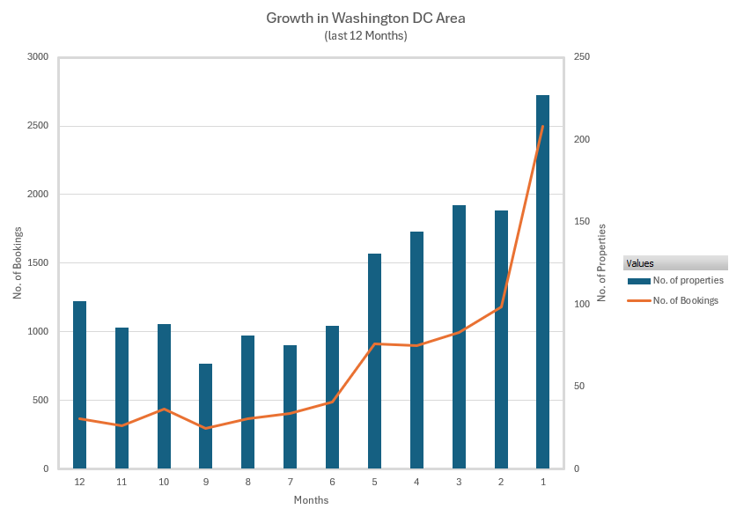
Recommendation #1 Client should enter the Washington DC Airbnb market
Last 12 Months Growth In Washington DC Area
The number of listings in the area increased from 102 to 227 per month in the last 12 months. That’s a growth of 122.55%.
The number of bookings has increased from 368 per month to 2496. That’s a growth of 578.26%.
Draw attention to the important parts of this slide:
Red circles/lines for highlighting important parts of the slides
Bold numbers to highlight them
Bold keywords in the bullet points help draw attention to the important text
The title is a larger font than all the other text on the slide, and it has a big blue line underneath to separate it from the rest of the text

Slide 12
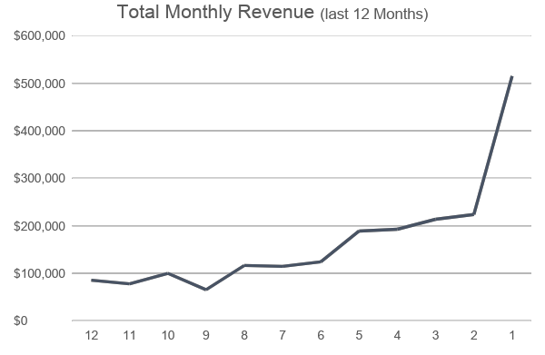
Recommendation #1 Client should enter the Washington DC Airbnb market
Last 12 Months Growth In Washington DC Area
The total revenue generated by the properties increased from $77912 to $515210 in the last 12 months.
This growth shows that there is a consistent increase in demand even with increasing number of listings.
The consistent increase in bookings and revenue irrespective of the increase in the no. of listings shows that Washington DC has high potential for growth.
Draw attention to the important parts of this slide:
Red circles/lines for highlighting important parts of the slides
Bold numbers to highlight them
Bold keywords in the bullet points help draw attention to the important text
The title is a larger font than all the other text on the slide, and it has a big blue line underneath to separate it from the rest of the text

Slide 13
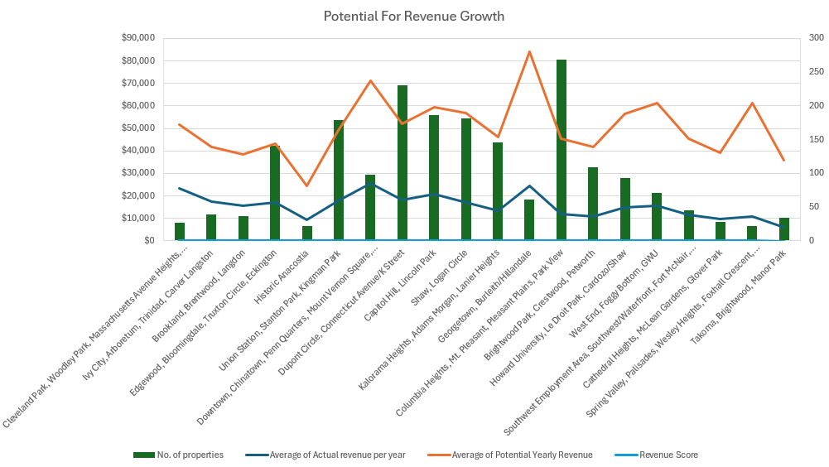
Recommendation #1 Client should enter the Washington DC Airbnb market
Earning Potential for Neighborhoods
Most if the neighborhoods are not earning as much as they can. This shows that there is untapped potential for growth.
Draw attention to the important parts of this slide:
Red circles/lines for highlighting important parts of the slides
Bold numbers to highlight them
Bold keywords in the bullet points help draw attention to the important text
The title is a larger font than all the other text on the slide, and it has a big blue line underneath to separate it from the rest of the text

Slide 14
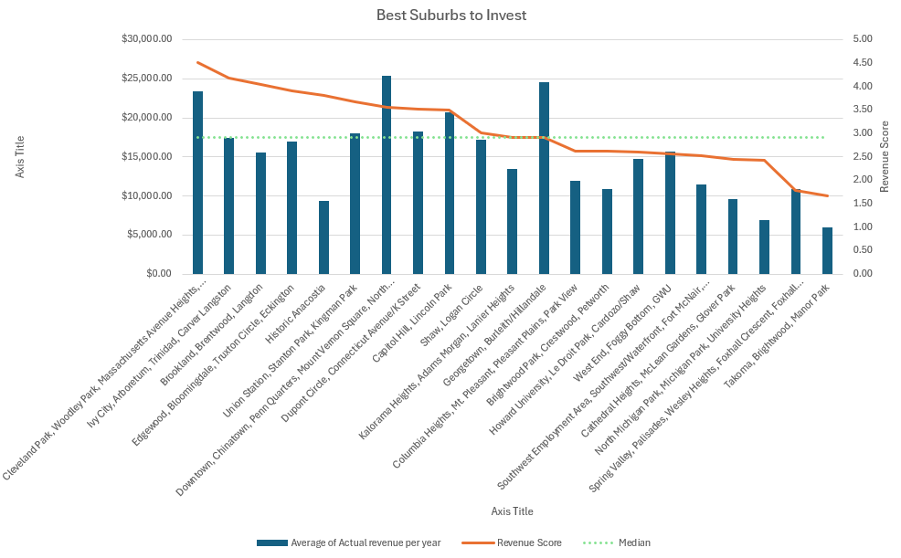
Recommendation #2 Cleveland Park, Woodley Park, Massachusetts Avenue Heights, Woodland-Normanstone Terrace are the best neighborhoods for investment
Earning Potential for Neighborhoods
A revenue score was calculated for each suburb out of 10, by dividing the current revenue with potential revenue. This score shows how close a neighborhood sits close to its potential earning
A median score was calculated for the revenue score to create a cutoff.
The neighbourhoods that score above median score are good for investments.
The best neighbourhood would be the ones that generate the most revenue per listing and has high ‘revenue score’.
Draw attention to the important parts of this slide:
Red circles/lines for highlighting important parts of the slides
Bold numbers to highlight them
Bold keywords in the bullet points help draw attention to the important text
The title is a larger font than all the other text on the slide, and it has a big blue line underneath to separate it from the rest of the text

Slide 15
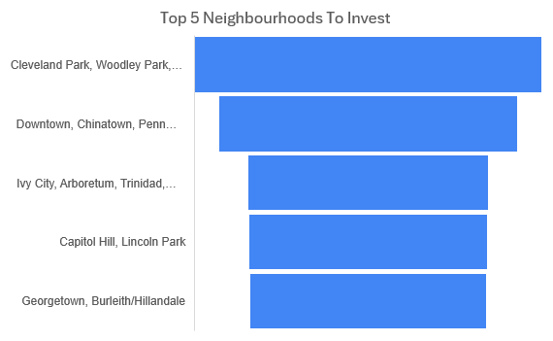
Recommendation #2 Cleveland Park, Woodley Park, Massachusetts Avenue Heights, Woodland-Normanstone Terrace are the best neighborhoods for investment
Top 5 Neighborhoods for Investments
A combination of top revenue per listing and high ‘revenue score’ indicates a top neighborhood.
A ‘top choice score’ was calculated by multiplying the current avg. earnings from a neighborhood with its ‘revenue score’.
This new score system helped to identify neighborhoods that are the best in terms of avg. revenue and closeness to their earning potential.
Draw attention to the important parts of this slide:
Red circles/lines for highlighting important parts of the slides
Bold numbers to highlight them
Bold keywords in the bullet points help draw attention to the important text
The title is a larger font than all the other text on the slide, and it has a big blue line underneath to separate it from the rest of the text

Slide 16
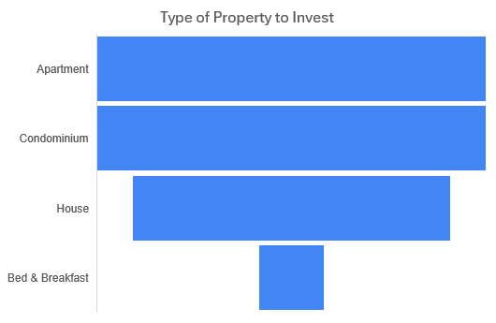
Recommendation #2 Cleveland Park, Woodley Park, Massachusetts Avenue Heights, Woodland-Normanstone Terrace are the best neighborhood group for investment
Top Property Types for Investments
The property types from top 5 neighborhoods listed in the previous slide was selected.
A ‘top choice score’ was calculated by multiplying the current avg. earnings from a property type with its ‘revenue score’.
This new score system helped to identify properties that are the best in terms of avg. revenue and closeness to their earning potential.
Draw attention to the important parts of this slide:
Red circles/lines for highlighting important parts of the slides
Bold numbers to highlight them
Bold keywords in the bullet points help draw attention to the important text
The title is a larger font than all the other text on the slide, and it has a big blue line underneath to separate it from the rest of the text

Slide 17
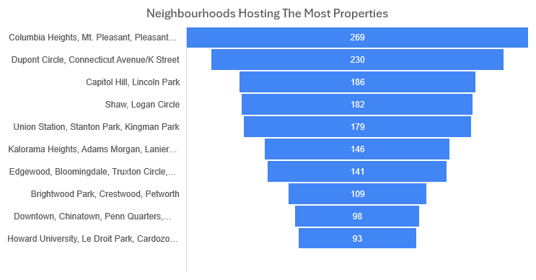
Prompt #3 Neighborhoods Hosting The Most Listings
Draw attention to the important parts of this slide:
Red circles/lines for highlighting important parts of the slides
Bold numbers to highlight them
Bold keywords in the bullet points help draw attention to the important text
The title is a larger font than all the other text on the slide, and it has a big blue line underneath to separate it from the rest of the text

Slide 18
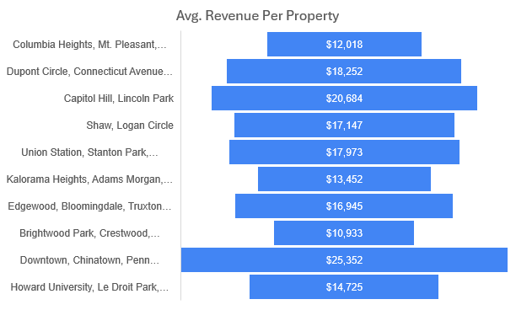
Prompt #3 Neighborhoods Hosting The Most Listings
Draw attention to the important parts of this slide:
Red circles/lines for highlighting important parts of the slides
Bold numbers to highlight them
Bold keywords in the bullet points help draw attention to the important text
The title is a larger font than all the other text on the slide, and it has a big blue line underneath to separate it from the rest of the text

Slide 19
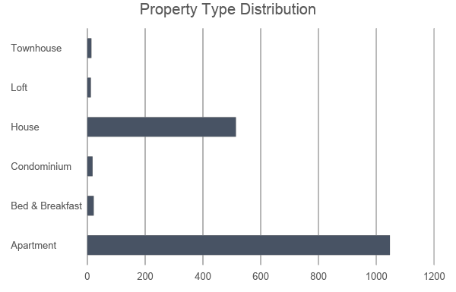
Prompt #3 Neighborhoods Hosting The Most Listings
Draw attention to the important parts of this slide:
Red circles/lines for highlighting important parts of the slides
Bold numbers to highlight them
Bold keywords in the bullet points help draw attention to the important text
The title is a larger font than all the other text on the slide, and it has a big blue line underneath to separate it from the rest of the text

Slide 20
Recommendations and Conclusion
In terms of property types, focusing on apartments and houses is likely to yield the best returns due to their high ratings and popularity.
Neighborhoods like Cleveland Park, Capitol Hill and Dupont Circle.

Slide 21
Thank You

